Slide 1
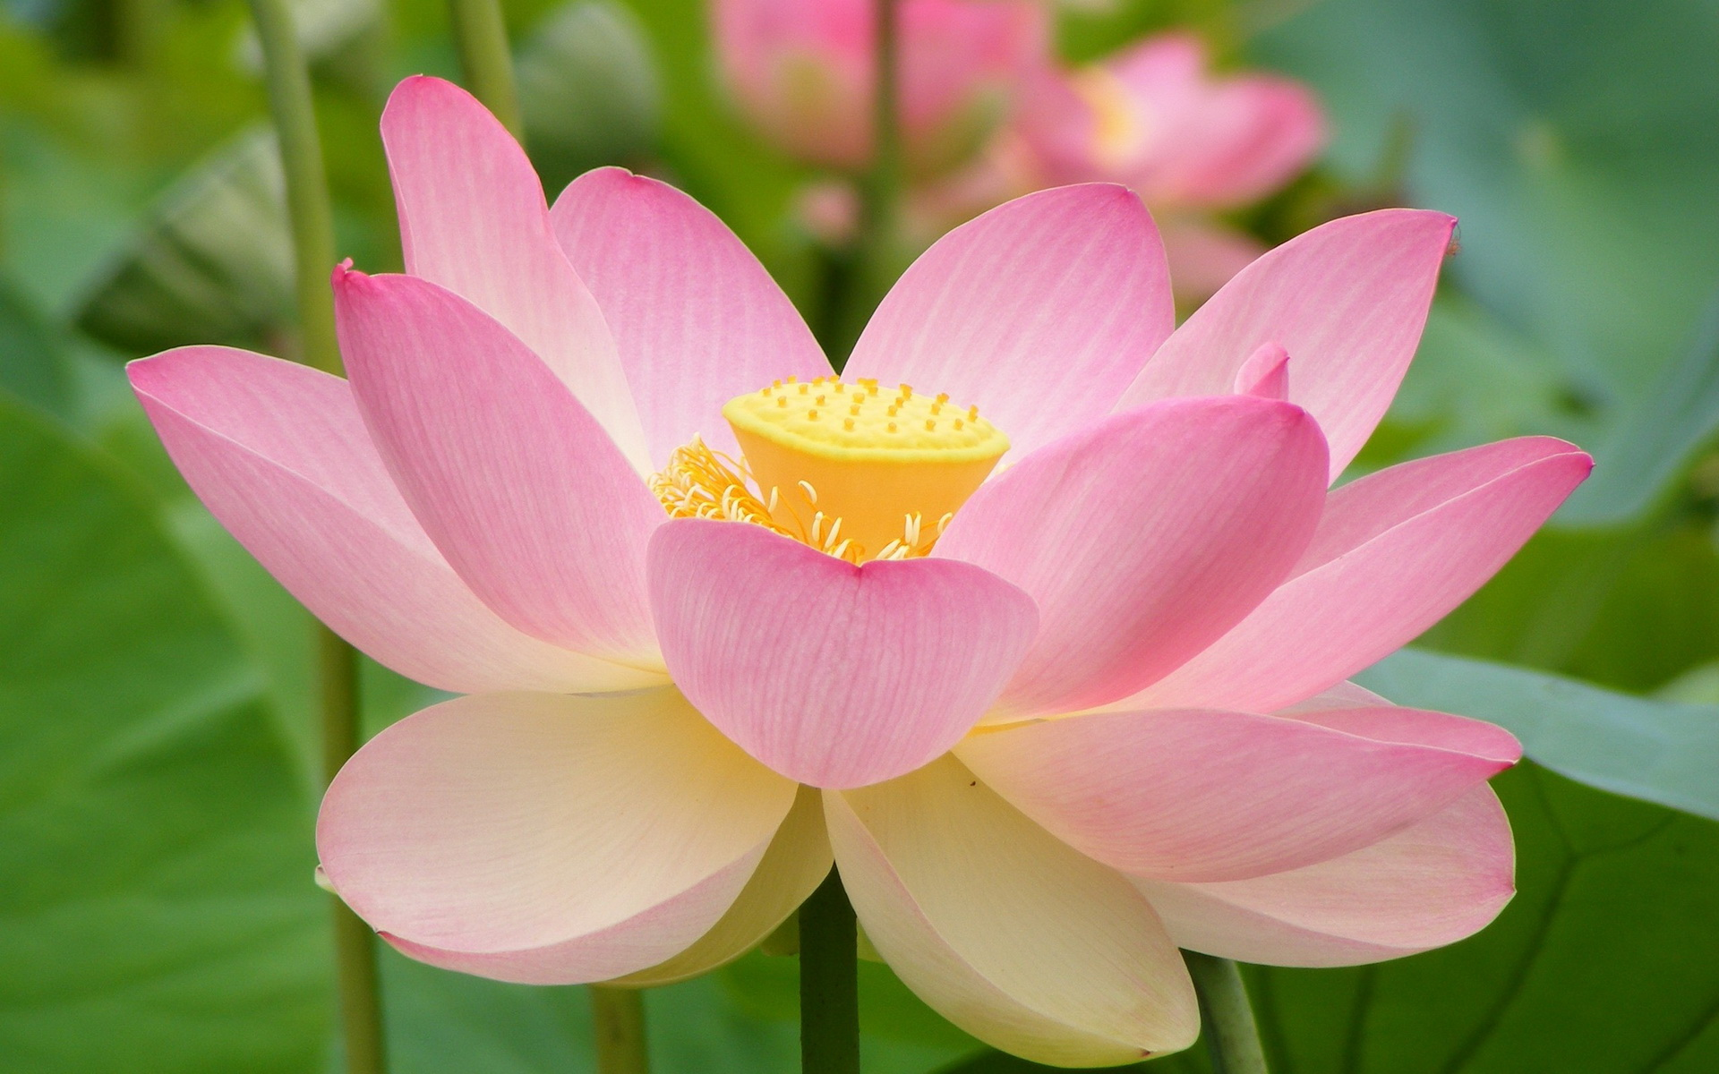
HUA’ER: A VIVID TAPESTRY OF CHINESE FOLK SINGING

Slide 2
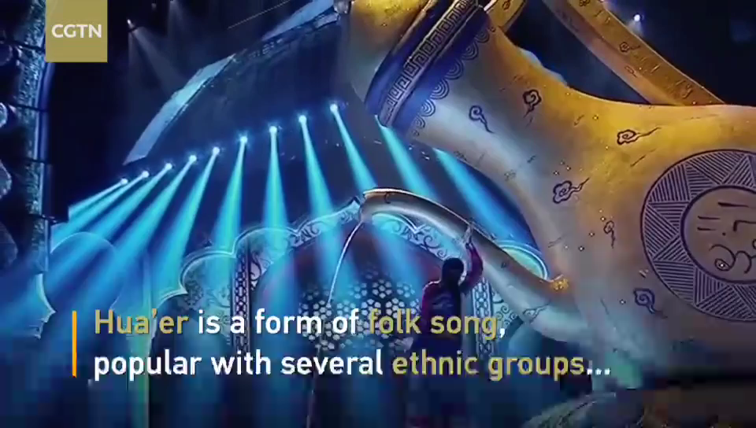

Slide 3
Brief Introduction
Hua'er originated in the early Ming Dynasty.
Its name, which translates to "flower," comes from the lyrics that often liken women to flower.
Free-form vocal improvisation, wide-ranging themes, and profound emotional depths.

Slide 4
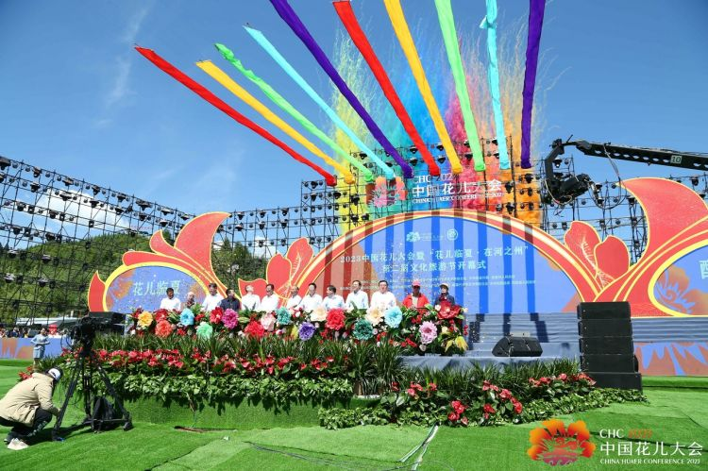
Hua’er meetings or competitions are held annually because of the special value and multi-ethnic cultural exchange and emotional bending.

Slide 5
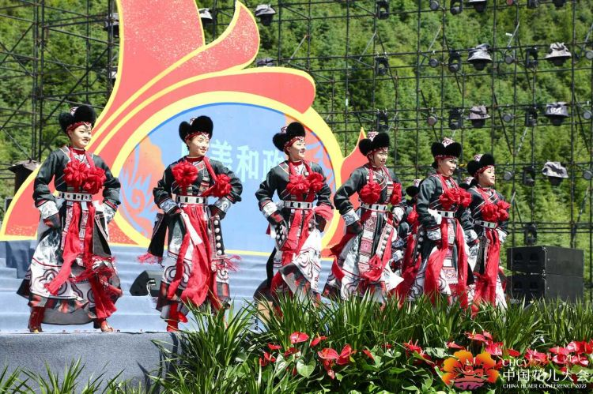
Characteristics and Themes
The music is drawn from an extensive traditional repertoire named after ethnicities, towns or flowers (“Tu People’s ling’, ‘White Peony ling ‘)
Songs may tell of young love, the hard work and weariness of the farming life, the foibles of men and women or the joy of singing.

Slide 6

Preservation and Recognition
Hua'er was inscribed on the UNESCO Representative List of the Intangible Cultural Heritage of Humanity in 2009

